Slide 1
MIND BLOWING TEACHING & LEARNING Jack Powers Interactive Technology & Pedagogy Program March 2011

Slide 2
NBIC Nanotechnology Biotechnology Information Technology Cognitive Science
NSF: Converging Technologies for Improving Human Performance
http://www.wtec.org/ConvergingTechnologies/Report/NBIC_report.pdf

Slide 3
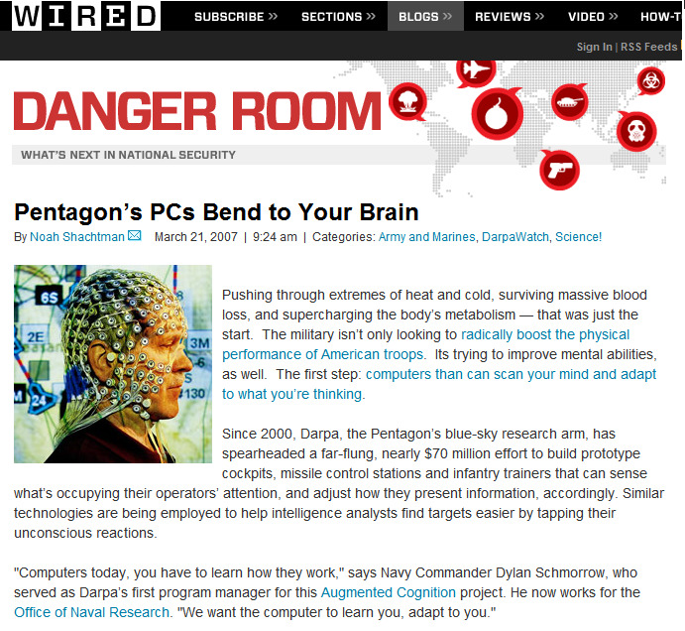
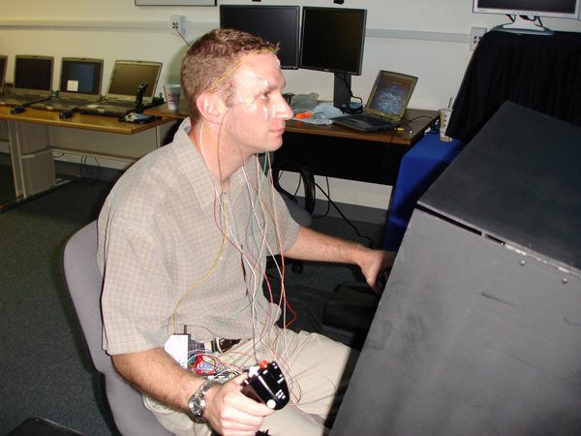
Augmented Cognition

Slide 4
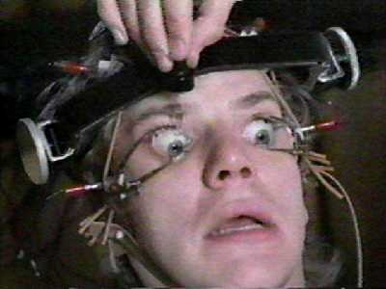
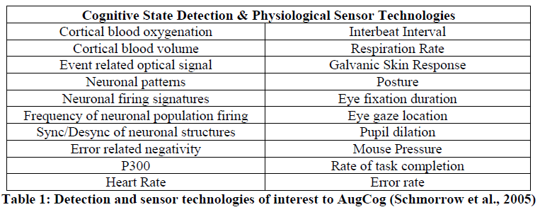

Slide 5
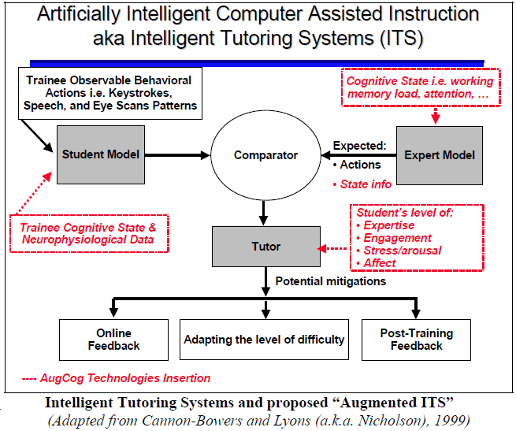

Slide 6
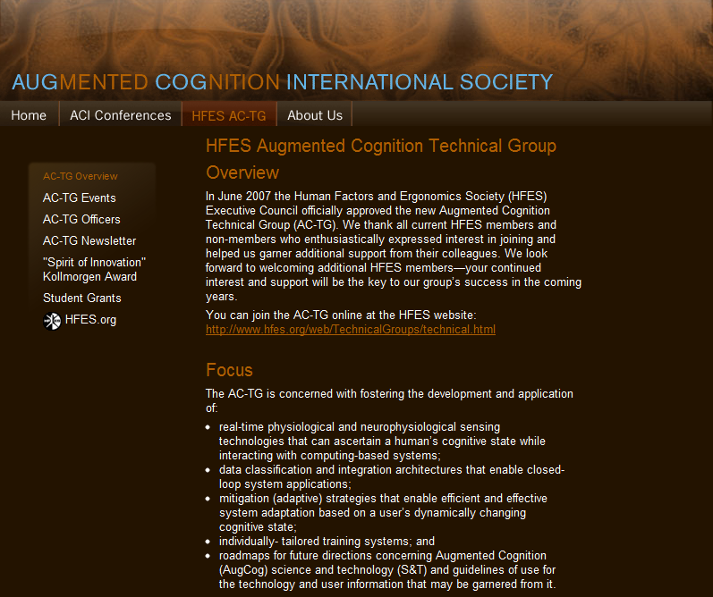

Slide 7
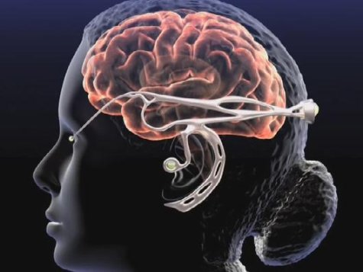
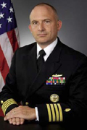
Dylan Schmorrow, PhD.
Captain, Medical Service Corps, US Navy, Office of the Secretary of Defense,
Acting Director, Biosystems and
Office of the Secretary of Defense,
Associate Director, Human Systems.

Slide 8
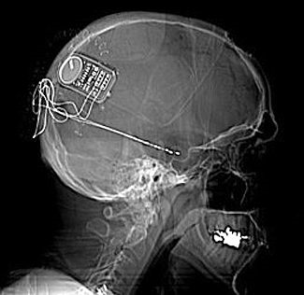
Brain Co-Processor

Slide 9
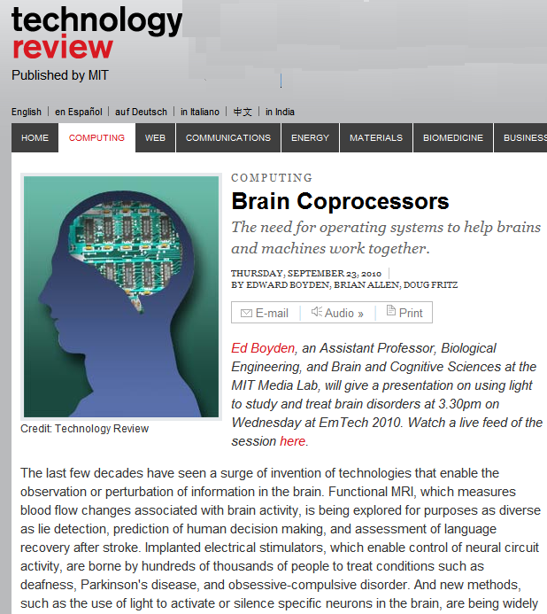
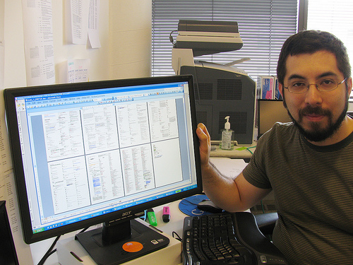

Slide 10
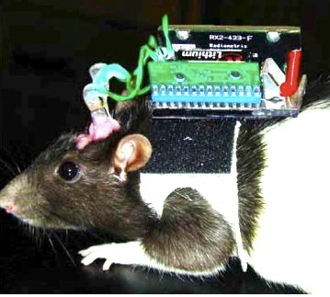
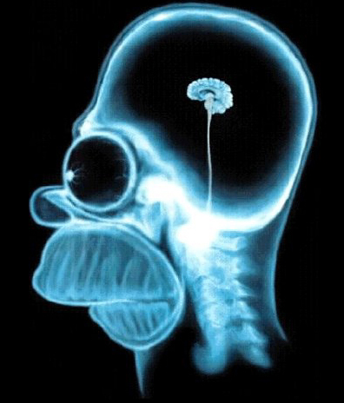
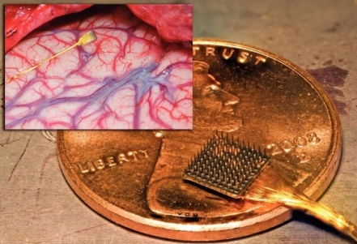

Slide 11
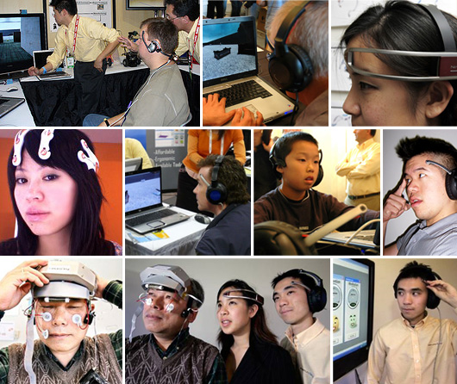
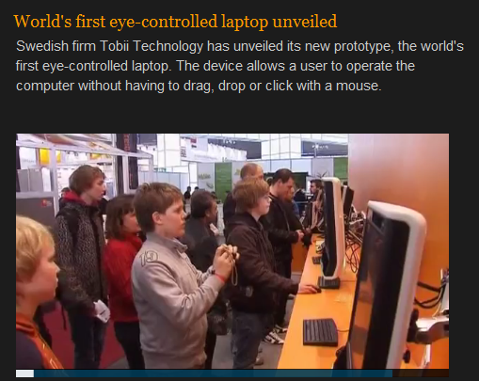

Slide 12
Pharmaceutical Enhancement

Slide 13
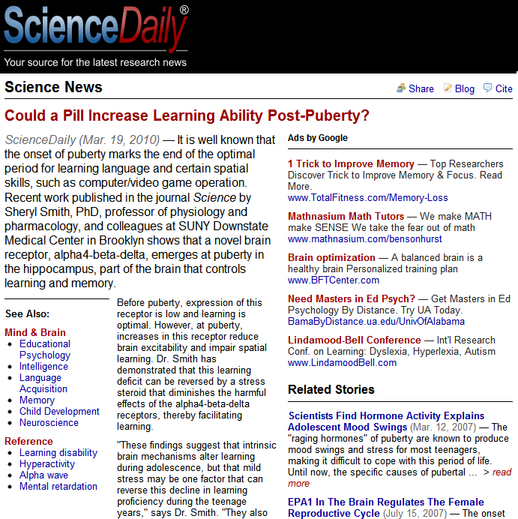
brain receptor alpha4-beta-delta

Slide 14
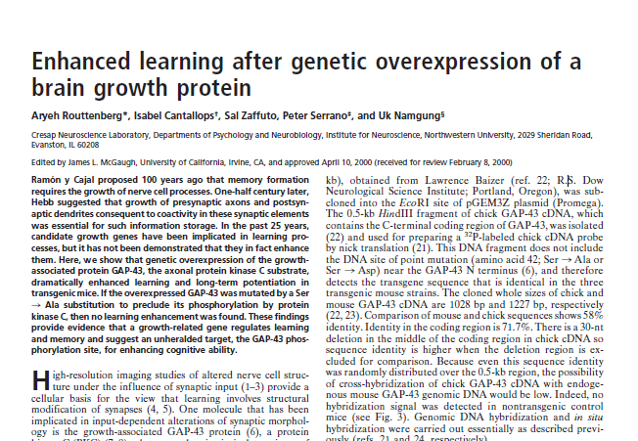
Genetic Enhancement

Slide 16
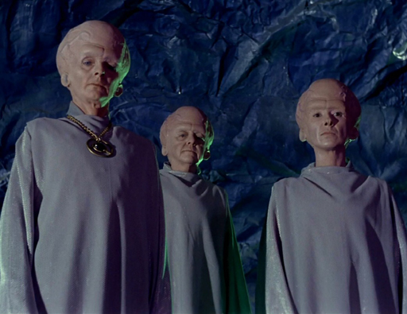

Slide 17
