Slide 1
The Future of Work
Jack Powers
International Informatics Institute
Institute for Career & Technical Education
NYC Advisory Council for Career & Technical Education

Slide 2
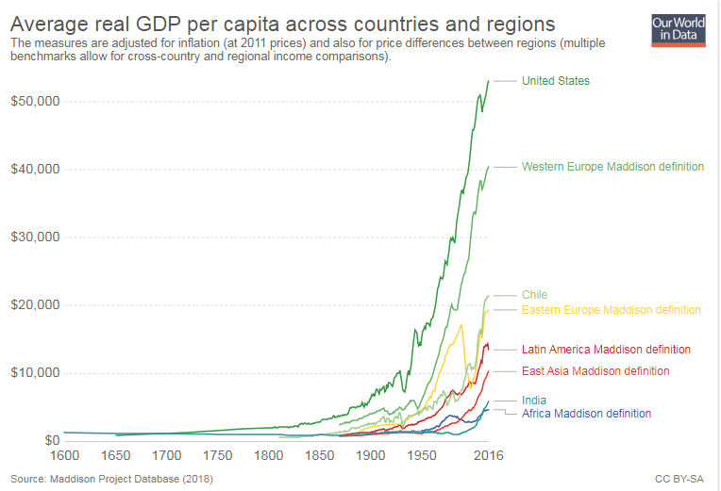
Global Economy

Slide 3
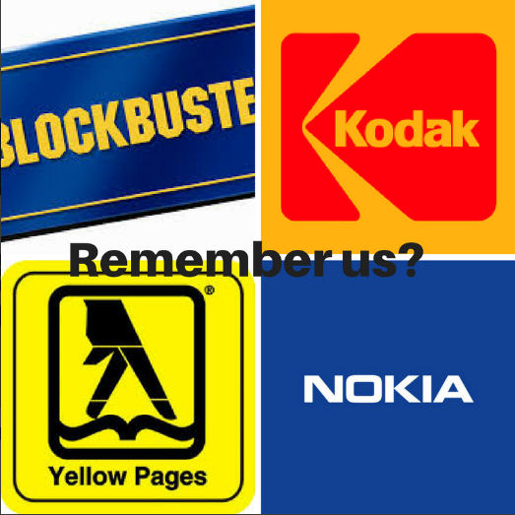
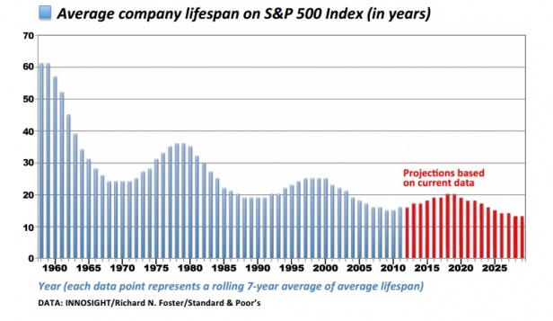
Future of Companies

Slide 4
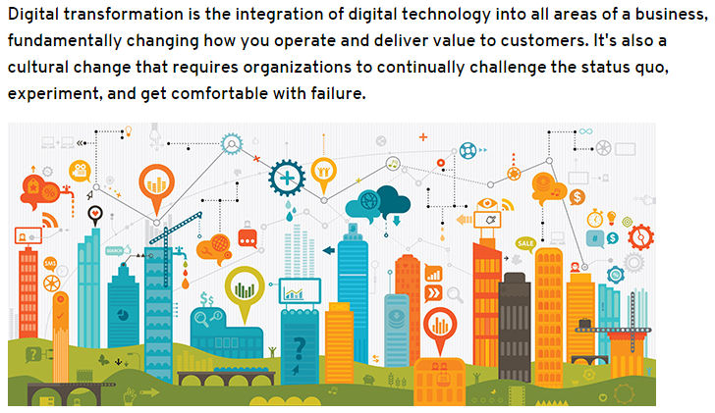
Digital Transformation
CLOUD COMPUTING
BIG DATA AND AI
INTERNET OF THINGS
INDUSTRY 4.0

Slide 5
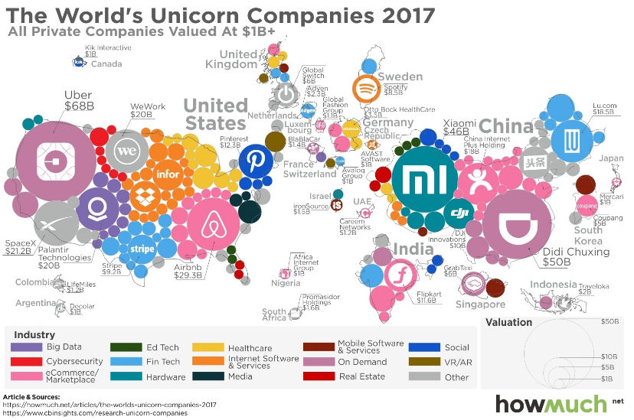
Young Digital Competitors

Slide 6
Fewer Workers, More Wealth
Eastman Kodak
Founded 1880
143,300 employees
$1.54 billion market capitalization in 2014, $180 million in 2018
Instagram
Founded 2010
15 employees
$1 billion sale to Facebook in 2012
Facebook
Founded 2004
17,000 employees
$388 billion market capitalization in 2018

Slide 7
Workers per $10 Million Revenue
Google 8
Facebook 6
Publicis Advertising 60
Amazon 17
Macy’s Department Store 62
Sears Department Store 63
Apple 5
Samsung 94
HP 112
Source: L2Inc.

Slide 8
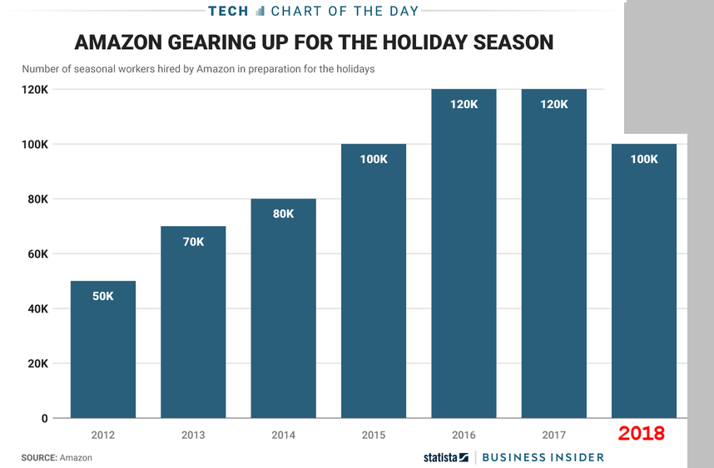
Accelerating. Automation

Slide 9
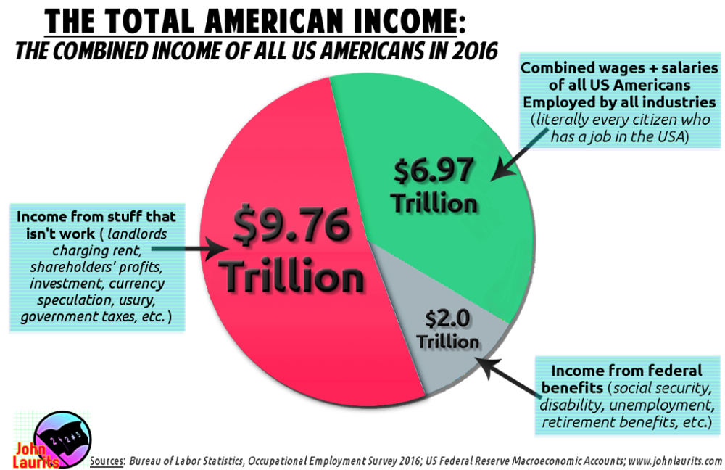

Slide 10
Uncompensated Work
WORK 24-Hour Access Unpaid Overtime Professional Development Networking Mentoring Industry Associations Open Source Projects | LIFE Care Work Personal Development Church Groups Fraternal Associations Social Media
SHIFTED Data Entry E-Commerce Sourcing Diagnosis & Repair | SHIFTED Data Entry E-Commerce Sourcing Diagnosis & Repair Cybersecurity

Slide 11
Future of Jobs
Digital Transformation Framework
Financialized Landscape
Disruptive Business Models
Contingent Workforces
Commercial & Regulatory Compliance

Slide 12
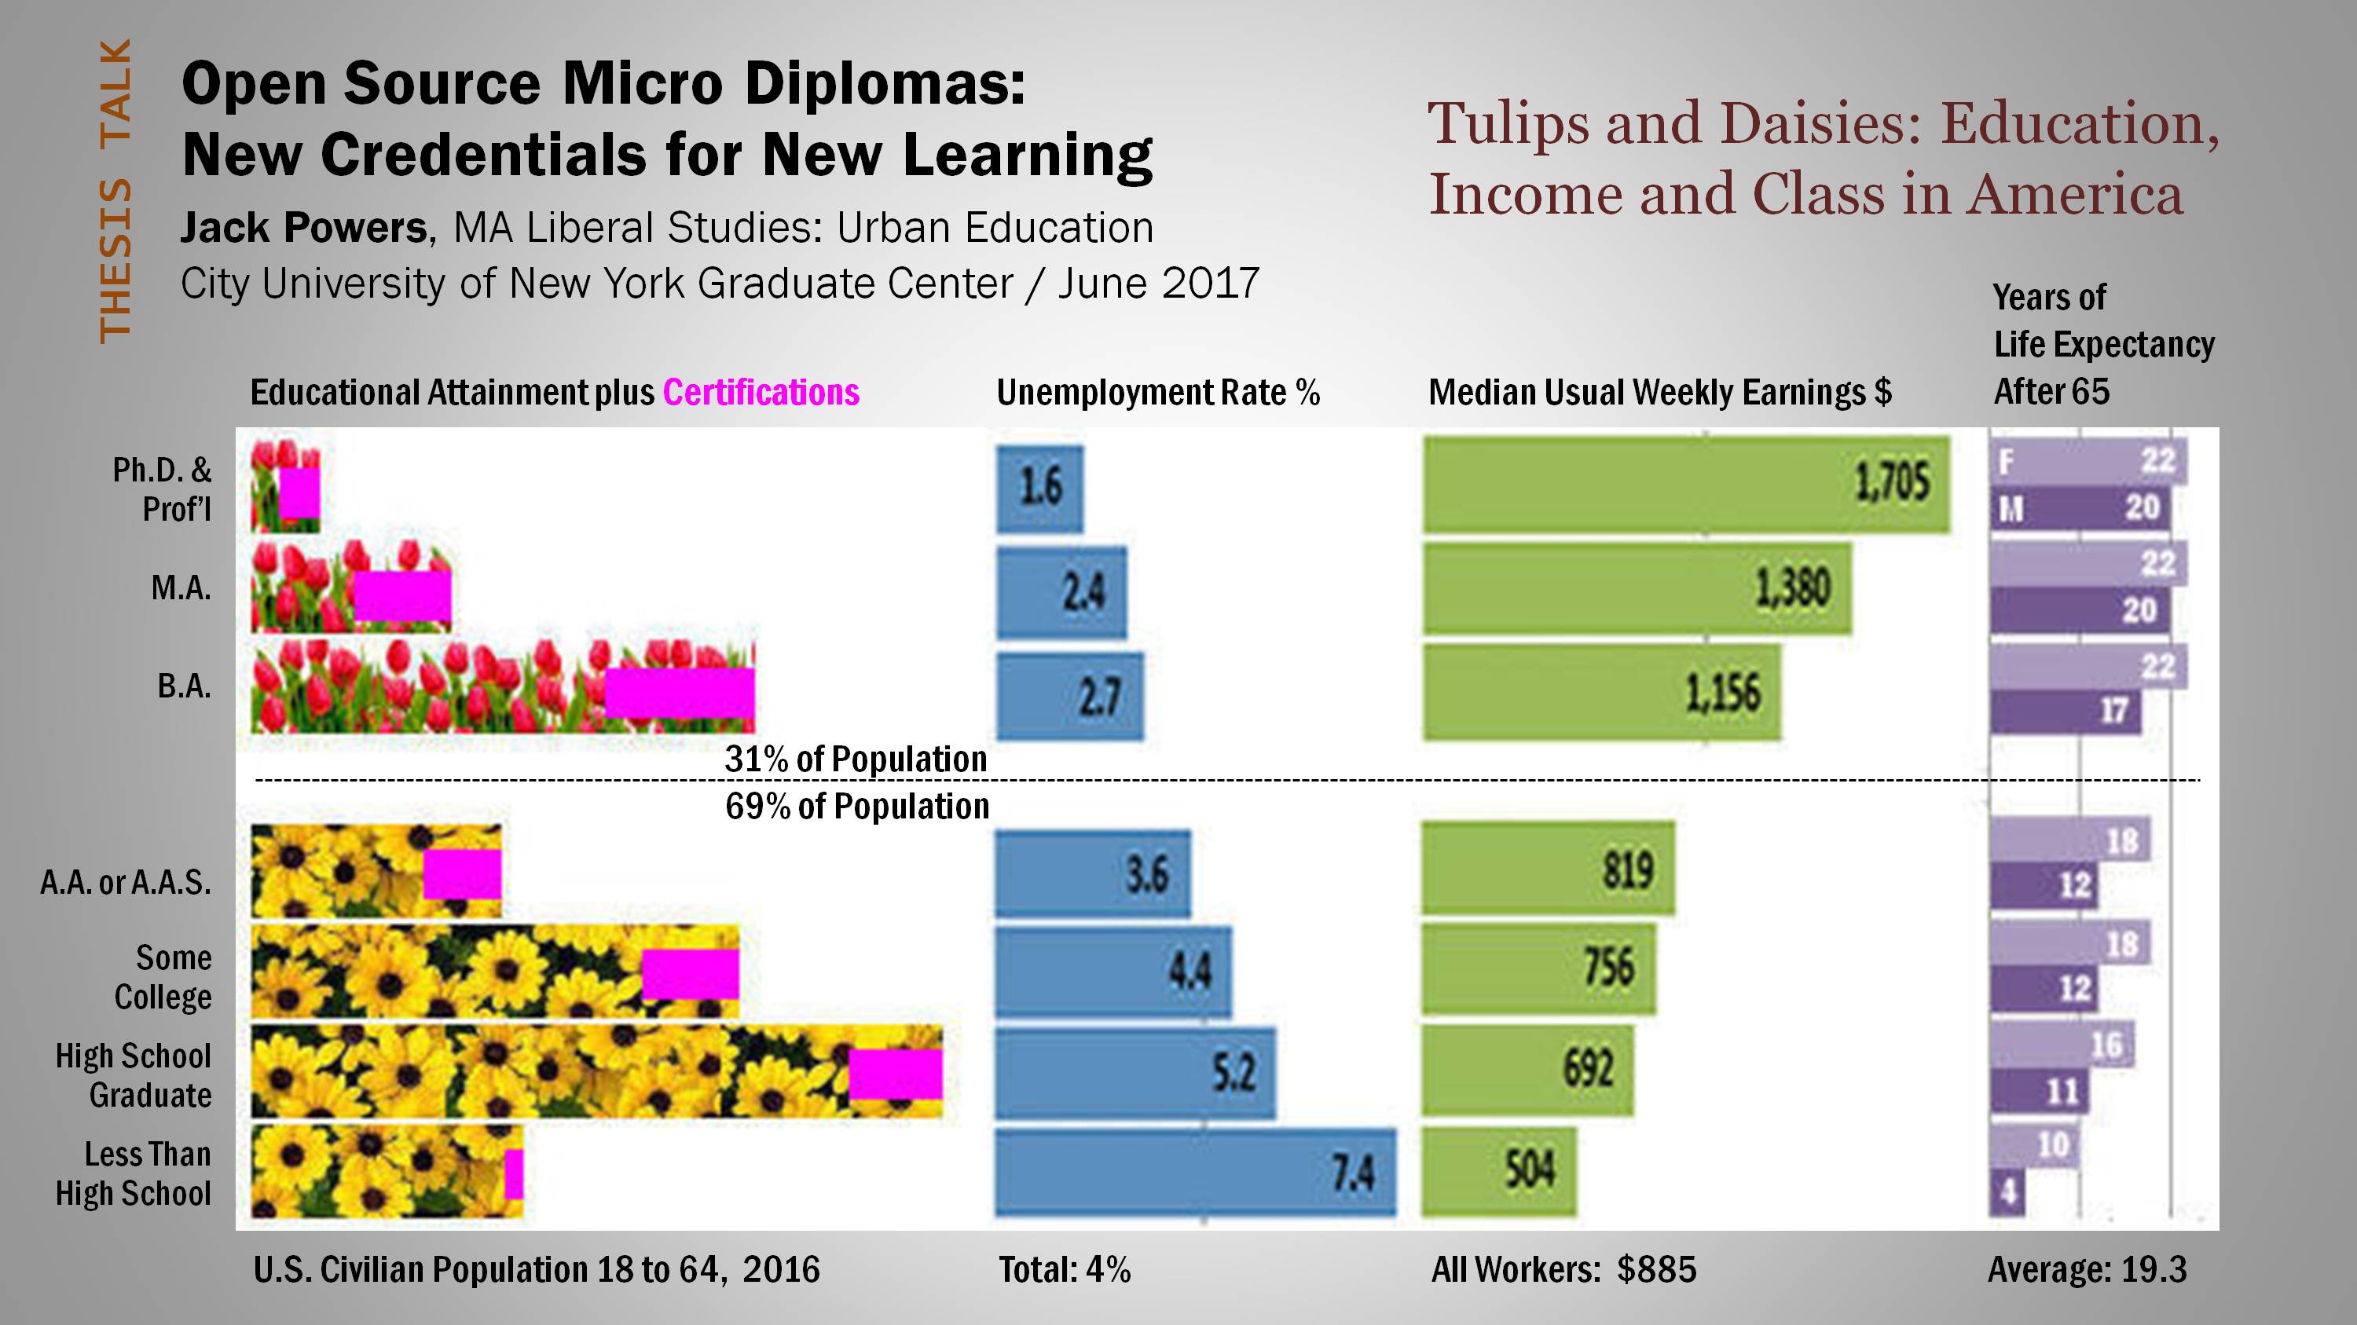
Education & Jobs

Slide 13
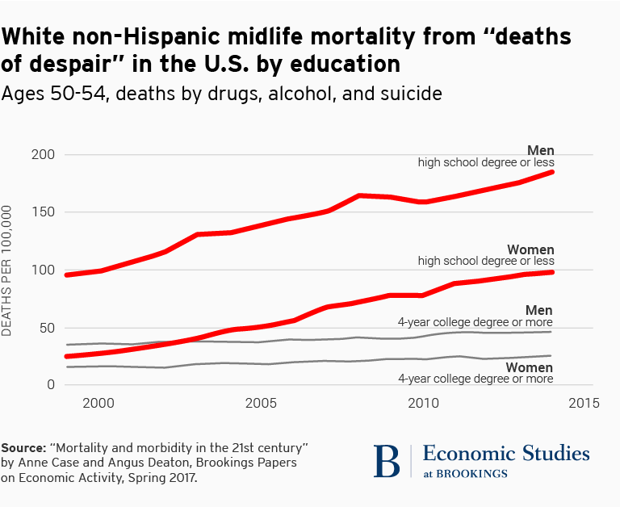
Education and Longevity

Slide 14
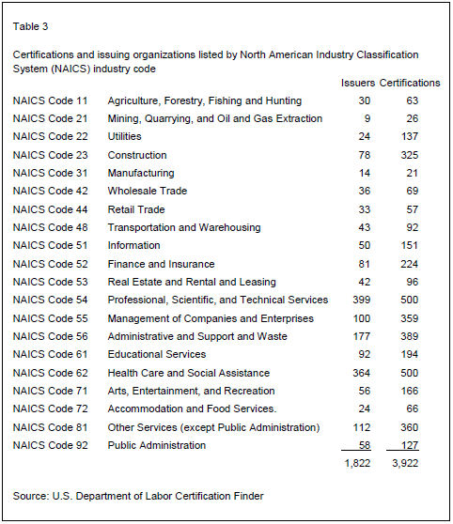
1,822
Curricula
3,922 Certifications

Slide 15
Finding a Job
On-Line Reputation Management
Adult email, clean record, linked e-Portfolio
Digital Resume Customized, updated, linked to Open Badges
ATS: Applicant Tracking Systems Optimized text, keywords, PDF or DOCX, no images
Video Interviews and Hire-Vue

Slide 16
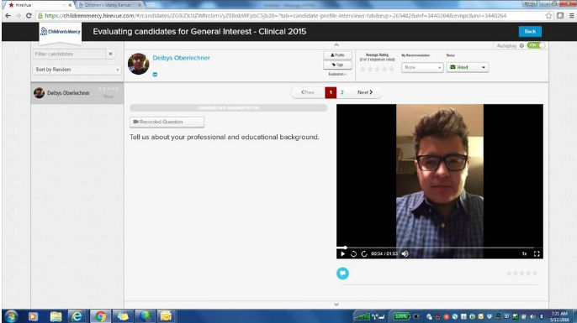

Slide 17
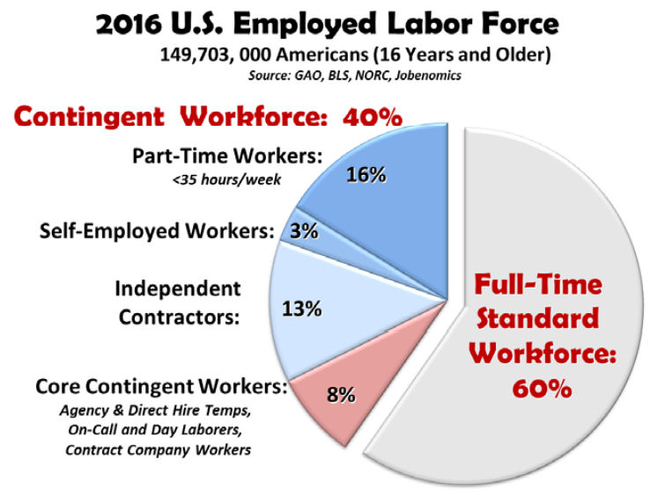
Contingent Labor

Slide 18
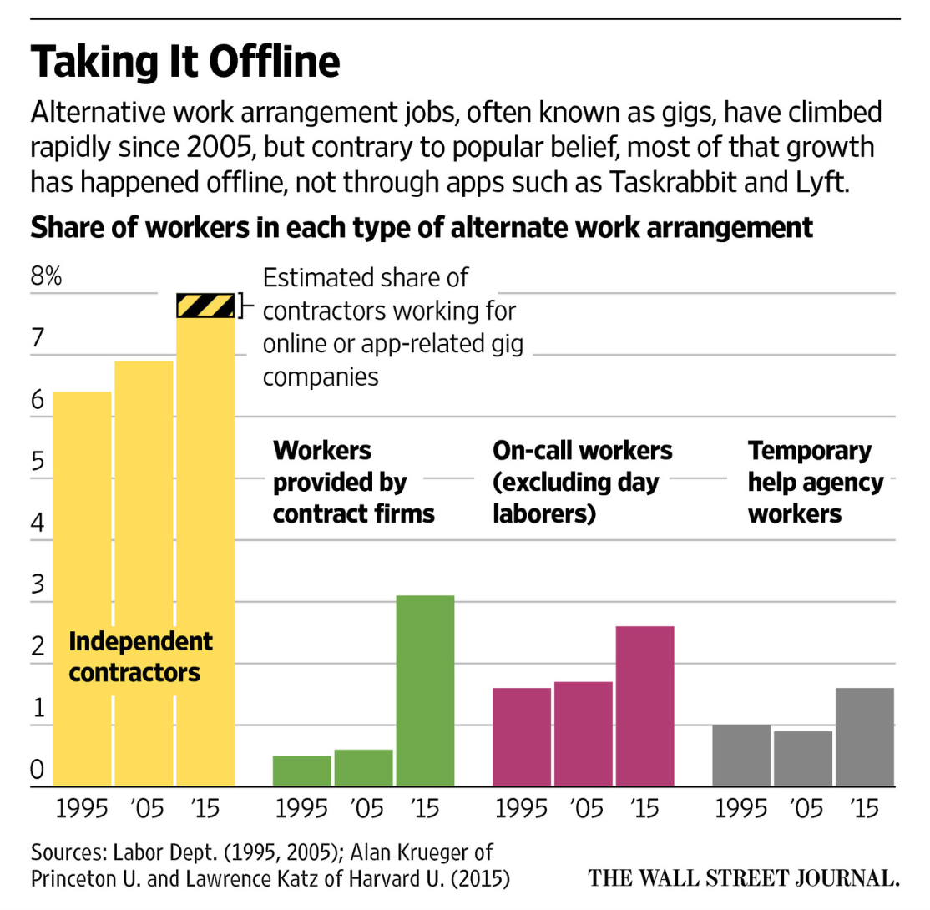
The Gig Economy

Slide 19
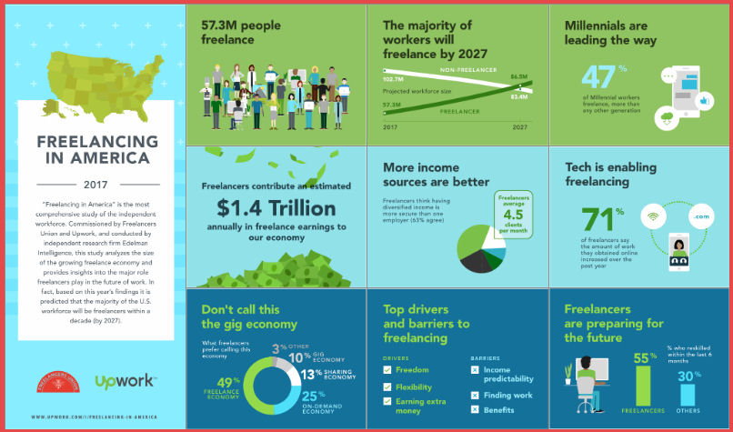
The Gig Economy

Slide 20
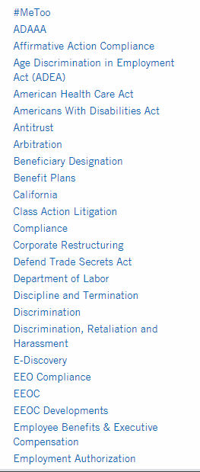
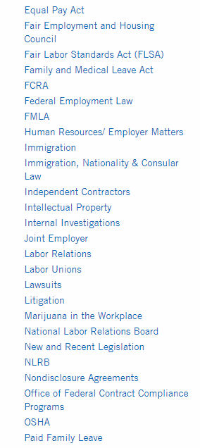
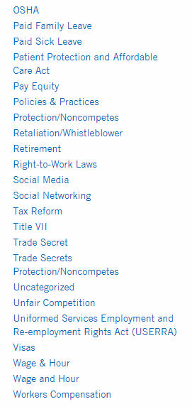
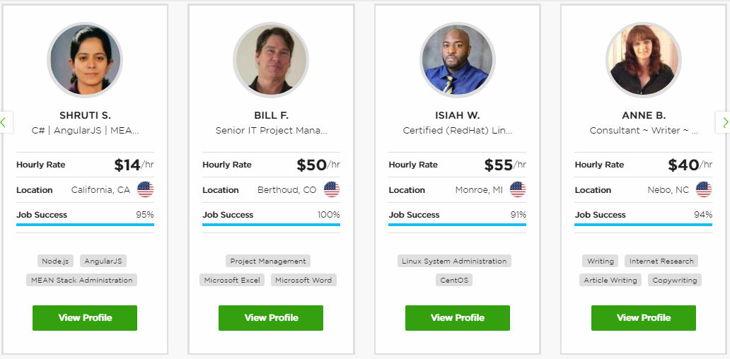
Compliance Society

Slide 21
The Gig Economy
W-2 EMPLOYEE STATUS Federal, state and local tax plus FICA withholding Minimum wage OSHA, COBRA, Disability Overtime pay Unemployment benefits Workers compensation Medical coverage Paid holidays and vacations Retirement benefits Collective bargaining Hazard and severance pay Family leave | 1099 INDEPENDENT CONTRACTOR STATUS Minimum hourly wage. OSHA No medical coverage, unemployment insurance, workers’ compensation, anti-discrimination law, fair chance hiring, paid sick leave, retirement benefits, or collective bargaining

Slide 22
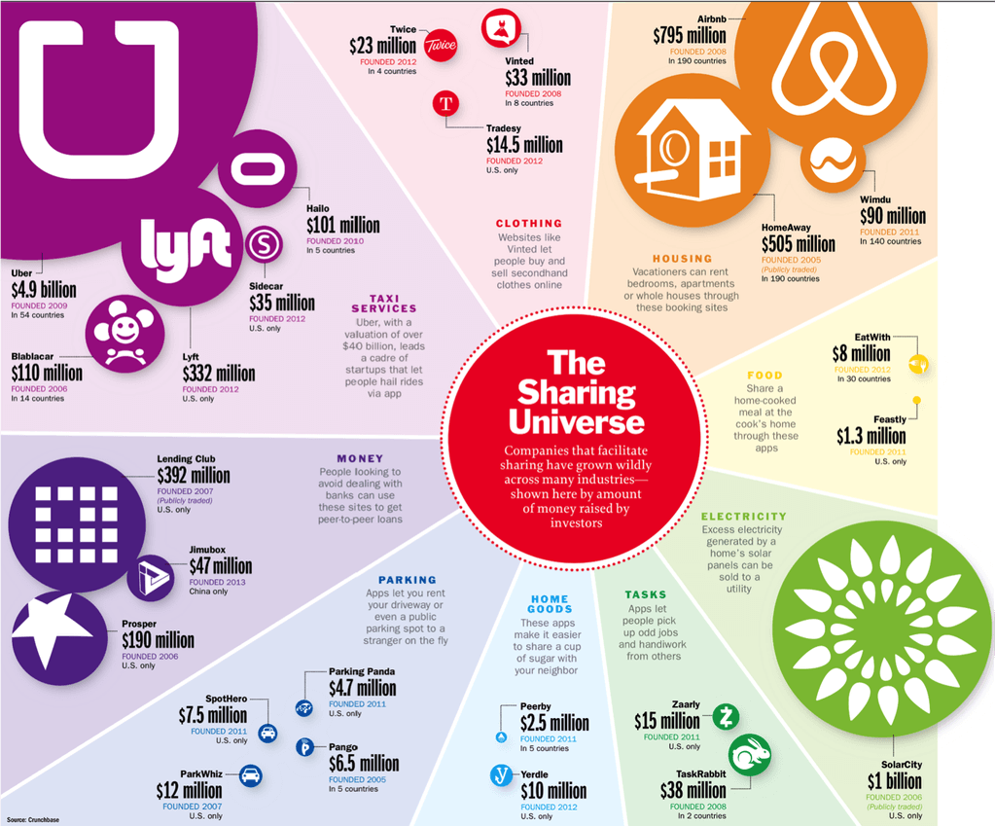
Precarious Work

Slide 23
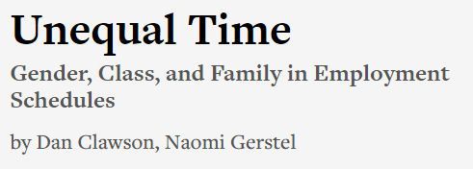
Gamification of Jobs

Slide 24
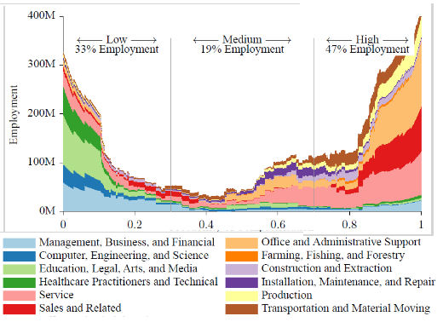
Probability of Computerisation
PHYSICAL FLEXIBILITY
ROUTINE TASKS
HIGH EXPERTISE
PREDICTABLE
EMPATHY
Carl Benedikt Frey, Michael A. Osborne, The Future Of Employment: How Susceptible Are Jobs To Computerisation?, Sept 2013

Slide 25
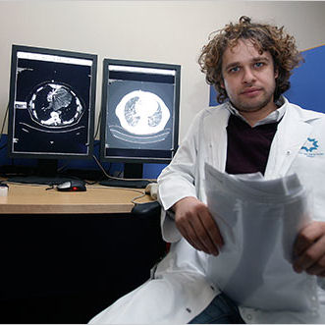
Medicine
RADIOLOGIST
PEDIATRICIAN

Slide 26
Probability of Computerisation
PHYSICAL FLEXIBILITY
ROUTINE TASKS
HIGH EXPERTISE
PREDICTABLE
EMPATHY
Carl Benedikt Frey, Michael A. Osborne, The Future Of Employment: How Susceptible Are Jobs To Computerisation?, Sept 2013

Slide 27
The Future of Work
Jack Powers
International Informatics Institute
Institute for Career & Technical Education
NYC Advisory Council for Career & Technical Education
JPowers@IN3.ORG
@JackPowers
IN3.ORG/FOJ

